Slide 1
Data Mining
Ch 10: Cluster Analysis
Examples of the k-means Algorithm
Wan D. Bae, Ph.D.
baewd@hanyang.ac.kr

Slide 2
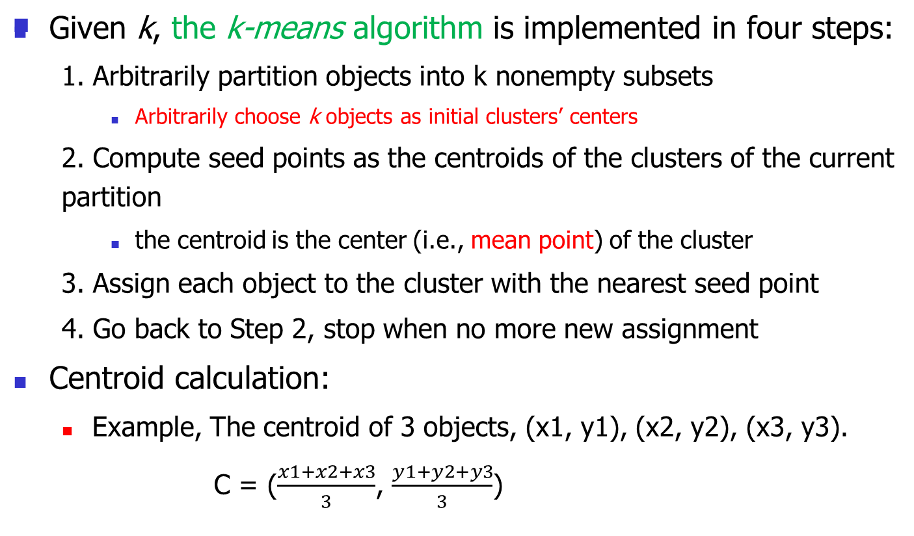
The k-means Algorithm

Slide 3
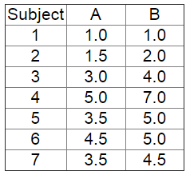
The k-means Algorithm: Example1
Dataset
  7 objects consisting of the scores of two variables (attributes), A and B.
This data set is to be grouped into two clusters (k = 2)

Slide 4
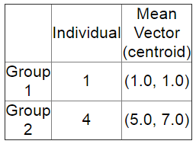
The k-means Algorithm: Example 1
As a first step in finding a sensible initial partition, let the A & B values of the two individuals furthest apart (using the Euclidean distance measure), define the initial cluster means.

Slide 5
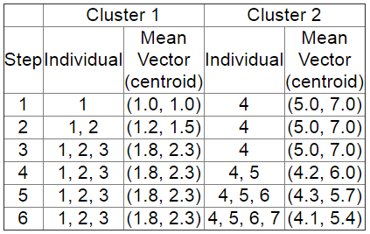
The k-means Algorithm: Example 1
The remaining individuals are examined in sequence and allocated to the cluster to which they are closest, in terms of Euclidean distance to the cluster mean.
  The mean vector is recalculated each time a new member is added. This leads to the following series of steps:

Slide 6
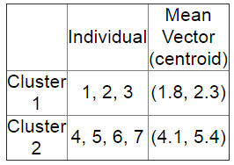
The k-means Algorithm: Example 1
Now the initial partition has changed, and the two clusters at this stage having the following characteristics:
But we cannot yet be sure that each individual has been assigned to the right cluster.

Slide 7
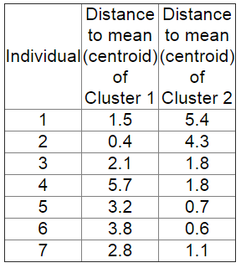
The k-means Algorithm: Example 1
So, we compare each individual’s distance to its own cluster mean and to that of the opposite cluster. And we find:
Only individual 3 is nearer to the mean of the opposite cluster (Cluster 2) than its own (Cluster 1).

Slide 8
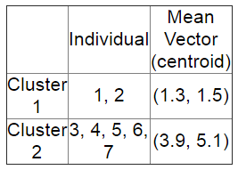
The k-means Algorithm: Example 1
Thus, individual 3 is relocated to Cluster 2 resulting in the new partition:
The iterative relocation would continue from this new partition until no more relocations occur.
However, in this example each individual is now nearer its own cluster mean than that of the other cluster and the iteration stops, choosing the latest partitioning as the final cluster solution.

Slide 9
The k-means Algorithm
It is possible that the k-means algorithm won't find a final solution.
  In this case it would be a good idea to consider stopping the algorithm after a pre-chosen maximum of iterations.

Slide 10
Example2
Suppose that we have 4 objects (4 types of medicines) and each object has two attributes of features, weight index and pH.
We want to group these objects into 2 groups of medicine based on the two features (k = 2)
Object | X₁ (Weight index) | X₂ (pH)
Medicine A | 1 | 1
Medicine B | 2 | 1
Medicine C | 4 | 3
Medicine D | 5 | 4

Slide 11
Example 2
Suppose we use medicine A and B as the initial centroids. We define the initial cluster means.
Let C1 and C2 denote the centroids. Then we have.
The remaining individuals are examined in sequence and allocated to the cluster to which they are closest, in terms of Euclidean distance to the cluster mean.
Continue the algorithm to determine the final two clusters.
Object | X₁ | X₂
Medicine A | 1 | 1
Medicine B | 2 | 1
Medicine C | 4 | 3
Medicine D | 5 | 4
C₁ = (1, 1)
C₂ = (2, 1)

